Slide 1
Chapter 6: CPU Scheduling NARZU TARANNUM(NAT) LECTURER DEPT. OF CSE, BRAC UNIVERSITY

Slide 2
Chapter 6: CPU Scheduling
Basic Concepts
Scheduling Criteria
Scheduling Algorithms
Examples

Slide 3
Basic Concepts behind CPU scheduling
CPU scheduling is the basis for multi-programmed operating systems.
In Multi-programmed system, a process is executed until it must wait, typically for the completion of some I/O request.
The objective of multi-programming is to have some process running at all times, to maximize CPU utilization.
With multi-programming, several processes are kept in the memory at one time, when one process has to wait, the operating system takes the CPU away from that process and gives the CPU to another process
To introduce CPU scheduling, here we describe various CPU-scheduling algorithms

Slide 4
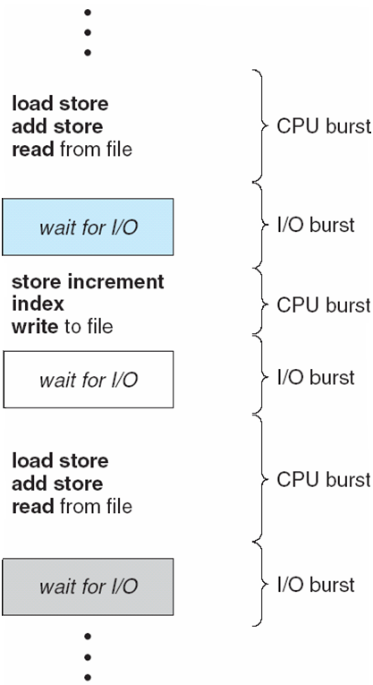
Basic Concepts
CPU–I/O Burst Cycle – Process execution consists of a cycle of CPU execution and I/O wait
Almost all processes alternate between two states in a continuing cycle, as shown in Figure below :
A CPU burst of performing calculations, and
An I/O burst, waiting for data transfer in or out of the system.
Processes alternate back and forth between this two states.
CPU burst distribution is of main concern

Slide 5
Preemptive and Non preemptive scheduling
Non-preemptive – Once CPU given to a process it cannot be preempted until completes its CPU burst or finish its work.
The process is not interrupted until its life cycle is complete.
preemptive – This term comes from the ability to remove a running process from CPU and allow another process to run in CPU.
The process can be interrupted, even before the completion.
Preempted process moves to ready queue/
Preemptive Scheduling is a CPU scheduling technique that works by dividing time slots of CPU to a given process. The time slot given might be able to complete the whole process or might not be able to it.
Algorithms that are backed by preemptive Scheduling are round-robin (RR), priority, SRTF (shortest remaining time first).

Slide 6
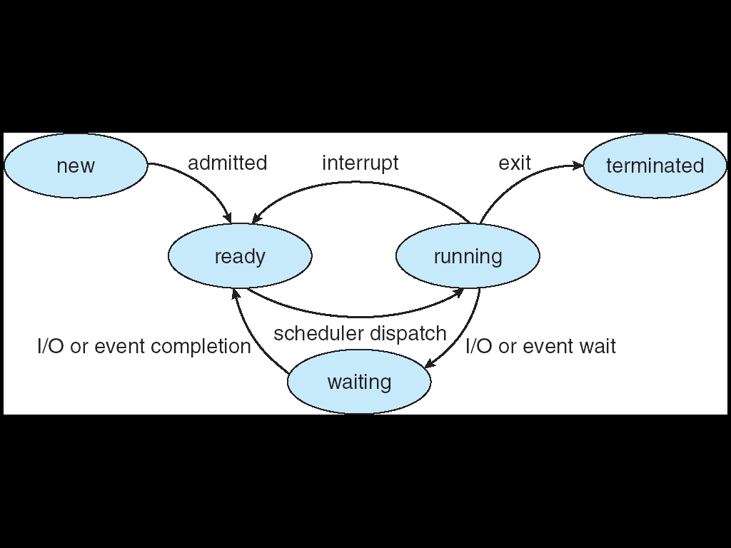
CPU Scheduler
Short-term schedular selects from among the processes in ready queue, and allocates the CPU to one of them for execution.
Queue may be ordered in various ways
CPU scheduling decisions may take place when a process:
1. Switches from running state to waiting state
2. Switches from running state to ready state
3. Switches from waiting state to ready state
Terminates
Scheduling under 1 and 4 is non-preemptive.
All other scheduling is preemptive.

Slide 7
Dispatcher
Dispatcher module gives control of the CPU to the process selected by the short-term scheduler; this involves:
switching context
switching to user mode
jumping to the proper location in the user program to restart that program
Dispatch latency – time it takes for the dispatcher to stop one process and start another running

Slide 8
Scheduling Criteria
CPU utilization – keep the CPU as busy as possible
Throughput – # of processes that complete their execution per time unit
Turnaround time – amount of time to execute a particular process
Waiting time – amount of time a process has been waiting in the ready queue
Response time – amount of time it takes from when a request was submitted until the first response is produced, not output (for time-sharing environment)
Fairness-Give each process a fair share of CPU.

Slide 9
Scheduling Algorithm Optimization Criteria
Max CPU utilization
Max throughput
Min turnaround time
Min waiting time
Min response time

Slide 10
First-Come, First-Served (FCFS) Scheduling Algorithm
The process that requests the CPU first is allocated CPU first
Implementation is easily managed with a FIFO queue
The FCFS scheduling algorithm is non-preemptive
Once the CPU has been allocated to a process, that process keeps the CPU until it release the CPU, either by terminating or by requesting I/O.

Slide 11
BT=Burst Time
CT=Completion Time
AT= Arrival Time
RS=Response Time
WT= Waiting Time
TA= Turn Around time
WT= FRS-AT / TA-BT
TA= CT-AT
Response time = Time at which the process gets the CPU for the first time - Arrival time

Slide 12
First-Come, First-Served (FCFS) Scheduling
Process Burst Time
P₁ 24
P₂ 3
P₃ 3
Suppose that the processes arrive in the order: P₁ , P₂ , P₃ The Gantt Chart for the schedule is:
Waiting time for P₁ = 0; P₂ = 24; P₃ = 27
Average waiting time: (0 + 24 + 27)/3 = 17
In this case average waiting time is quite long
P₁
P₂
P₃
0
24
27
30

Slide 13
FCFS Scheduling (Cont.)
Process Burst Time
P₁ 24
P₂ 3
P₃ 3
Suppose that the processes arrive in the order: P₂ , P₃ , P₁
The Gantt chart for the schedule is:
Waiting time for P₁ = 6; P₂ = 0; P₃ = 3
Average waiting time: (6 + 0 + 3)/3 = 3
The average waiting time is much better than the previous case; this reduction is substantial.
Thus the average waiting time under an FCFS policy is generally not minimal and may vary substantially if the processes CPU burst time vary greatly.
Convoy effect - short process behind long process
It would be disadvantageous to allow one process to keep the CPU for an extended period.
P₂
P₃
P₁
0
3
6
30

Slide 14
Shortest-Job-First (SJF) Scheduling
Associate with each process the length of its next CPU burst.
Use these lengths to schedule the process with the shortest time
preemptive – This term comes from the ability to remove a running process from CPU and allow another process to run in CPU.
if a new process arrives with CPU burst length less than remaining time of current executing process, preempt. This scheme is know as the Shortest-Remaining-Time-First (SRTF)
SJF is optimal – gives minimum average waiting time for a given set of processes
The difficulty is knowing the length of the next CPU request

Slide 15
Example of Non-Preemptive SJF
Process Arrival Time Burst Time
P₁ 0.0 7
P₂ 2.0 4
P₃ 4.0 1
P₄ 5.0 4
SJF (non-preemptive)
Average waiting time = (0 + 6 + 3 + 7)/4 = 4
P₁
P₃
P₂
P₄
0
3
7
8
12
16

Slide 16
Example of Preemptive SJF
Process Arrival Time Burst Time
P₁ 0.0 7
P₂ 2.0 4
P₃ 4.0 1
P₄ 5.0 4
SJF (preemptive)
Average waiting time = (9 + 1 + 0 +2)/4 = 3
P₁
P₂
P₃
P₂
P₄
P₁
0
2
4
5
7
11
16

Slide 17
Example of SJF
ProcessArriva l Time Burst Time
P₁ 0.0 6
P₂ 2.0 8
P₃ 4.0 7
P₄ 5.0 3
SJF scheduling chart
Average waiting time = (3 + 16 + 9 + 0) / 4 = 7
P₄
P₁
P₃
P₂
0
3
9
16
24

Slide 18
Example of Shortest-remaining-time-first
Now we add the concepts of varying arrival times and preemption to the analysis
ProcessA arri Arrival TimeT Burst Time
P₁ 0 8
P₂ 1 4
P₃ 2 9
P₄ 3 5
Preemptive SJF/SRTF Gantt Chart:
Average waiting time = [(10-1)+(1-1)+(17-2)+5-3)]/4 = 26/4 = 6.5 msec
P₁
P₂
P₄
P₁
P₃
0
1
5
10
17
26

Slide 19



Example of SJF(Preemptive)
Processes | Arrival time | CPU burst
P1 | 2 | 10
P2 | 4 | 6
P3 | 6 | 23
P4 | 8 | 8
P5 | 10 | 30
P6 | 12 | 3
P7 | 14 | 18

Slide 20
Homework
Draw a Gantt chart and find thruput, average waiting time, average turn around time, number of context switch using SRTF
Processes | Arrival time | CPU burst
P1 | 18 | 40
P2 | 29 | 17
P3 | 0 | 28
P4 | 21 | 37
P5 | 12 | 31

Slide 21
Determining Length of Next CPU Burst
Can only estimate the length – should be similar to the previous one
Then pick process with shortest predicted next CPU burst
The next CPU burst is generally predicted as an exponential average of the measured lengths of previous CPU bursts.
Commonly, α set to ½
Preemptive version called shortest-remaining-time-first

Slide 22

Determining Length of Next CPU Burst
Can only estimate the length – should be similar to the previous one
Then pick process with shortest predicted next CPU burst
The next CPU burst is generally predicted as an exponential average of the measured lengths of previous CPU bursts.
Commonly, α set to ½
Preemptive version called shortest-remaining-time-first

Slide 23
Examples of Exponential Averaging
α =0
τ_{n+1} = τ_{n}
Recent history does no effect
α =1
τ_{n+1} = α t_{n}
Only the most recent CPU burst matters
If we expand the formula, we get:
τ_{n+1} = α t_{n}+(1 - α)α t_{n} ₋₁ + …
+(1 - α )^{j} α t_{n} _{-j} + …
+(1 - α )^{n +1} τ₀
Since both α and (1 - α) are less than or equal to 1, each successive term has less weight than its predecessor
Commonly, if α is set to ½, so recent history and past history are equally weighted.
Next slide figure shows an exponential average with α =.5 and τ_{o}= 10

Slide 24
Prediction of the Length of the Next CPU Burst

Slide 25

Priority Scheduling
A priority number (integer) is associated with each process
The CPU is allocated to the process with the highest priority (smallest integer ≡ highest priority)
Priority scheduling can be either Preemptive or Non-preemptive
Equal-priority processes are schedule in FCFS order.
A preemptive priority scheduling algorithm will preempt the CPU if the priority of the newly arrived process is higher than the priority of the currently running process.
SJF is priority scheduling where priority is the inverse of predicted next CPU burst time
Problem ≡ Starvation – low priority processes may never execute
Solution ≡ Aging – as time progresses increase the priority of the process that wait in the system for a long time.

Slide 26
Example of Priority Scheduling(Non-preemptive)
ProcessA arri Burst TimeT Priority
P₁ 10 3
P₂ 1 1
P₃ 2 4
P₄ 1 5
P₅ 5 2
Priority scheduling Gantt Chart
Average waiting time = 8.2 msec
P₂
P₅
P₁
P₃
P₄
0
1
6
16
18
19

Slide 27
Example of Priority Scheduling(preemptive)
Consider the set of processes with arrival time (in milli second), CPU burst time, and priority (0 is the highest priority) shown bellow. None of the process have I/O burst time. The average waiting time of all process using preemptive priority scheduling algorithm is ___________.
(A) 29, (B) 30, (C) 31, (D) 32
Processes | Arrival time | Priority | CPU burst
P1 | 0 | 2 | 11
P2 | 5 | 0 | 28
P3 | 12 | 3 | 2
P4 | 2 | 1 | 10
P5 | 9 | 4 | 16

Slide 28


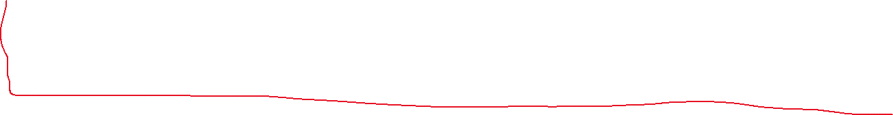
Processes | Arrival time | Priority | CPU burst
P1 | 0 | 2 | 11
P2 | 5 | 0 | 28
P3 | 12 | 3 | 2
P4 | 2 | 1 | 10
P5 | 9 | 4 | 16

Slide 29
Round Robin (RR)
The round-robin (RR) scheduling algorithm is designed especially for time sharing systems.
It is similar to FCFS scheduling, but preemption is added to switch between processes.
Each process gets a small unit of CPU time (time quantum q), usually 10-100 milliseconds. After this time has elapsed, the process is preempted and added to the end of the ready queue.
Timer interrupts every quantum to schedule next process.
Performance
The average waiting time under the round-robin policy is often long, it depends on the size of time quantum
If the time quantum is large, RR policy will become same as FCFS
If the time quantum is extremely small, RR approach can result in a large number of context switches. We can see it in next slide
Typically, higher average turnaround than SJF, but better response time.
q should be large compared to context switch time.

Slide 30
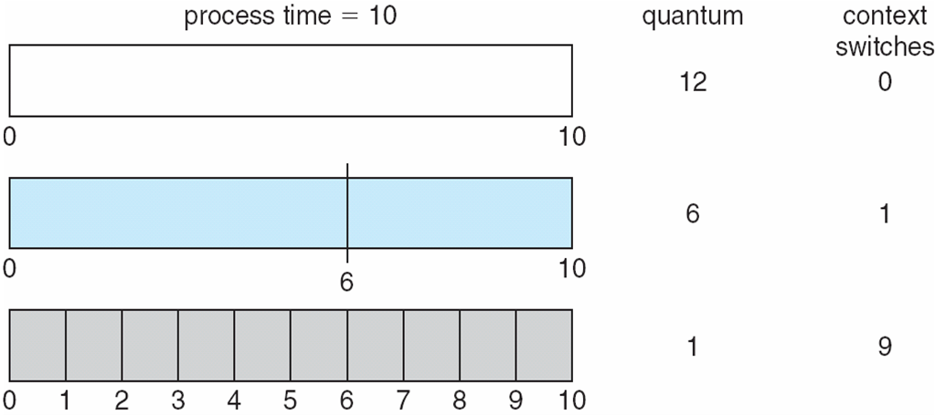
Time Quantum and Context Switch Time

Slide 31
Round Robin (RR)
Advantages – Every process gets an equal share of the CPU. RR is cyclic in nature, so there is no starvation.
Performs best in terms of average response time.
Disadvantages – Setting the quantum too short, increases the overhead and lowers the CPU efficiency, but setting it too long may cause poor response to short processes.
No idea of priority

Slide 32


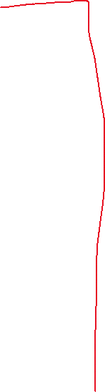



Example of RR with Time Quantum = 4
Process Burst Time
P₁ 24
P₂ 3
P₃ 3
The Gantt chart is:
P₁
P₂
P₃
P₁
P₁
P₁
P₁
P₁
0
4
7
10
14
18
22
26
30

Slide 33
Example of RR with Time Quantum =2ms
Process ID | Arrival Time | Burst time
P1 | 0 | 5
P2 | 1 | 3
P3 | 2 | 1
P4 | 3 | 2
P5 | 4 | 3

Slide 34
RR Homework with time quantum=7ms
Consider the set of processes with arrival time (in milli second) and CPU burst time shown bellow. Calculate average waiting time, average turn around time, throughput and number of context switch.
Process ID | Arrival Time | Burst time
P1 | 12 | 20
P2 | 9 | 17
P3 | 1 | 28
P4 | 7 | 23
P5 | 21 | 13

Slide 35
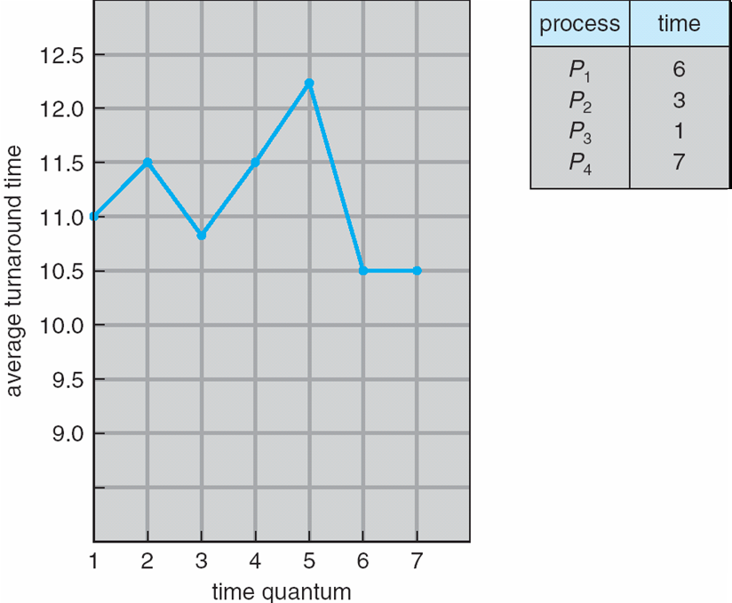
Turnaround Time Varies With The Time Quantum
Turnaround time also depends on the size of the time quantum.
We can see here in this figure the average turnaround time of a set of processes does not necessarily improve as the time quantum size increases.

Slide 36
Multilevel Queue
Another class of scheduling algorithm needs- in which processes are classified into different groups-e.x.:
foreground (interactive) processes
background (batch) processes
They have different response time requirements-so different scheduling needs.
Foreground processes may have priority over background processes.
A multilevel queue-scheduling algorithm partitions the ready queue into several separate queues-
we can see it in the figure of next slide:-
The processes are permanently assigned to one queue.
Each queue has its own scheduling algorithm:
Foreground queue scheduled by – RR algorithm
Background queue scheduled by – FCFS algorithm
Scheduling must be done between the queues or there must be scheduling among the queue.
Which is commonly implemented as fixed priority preemptive scheduling; (i.e., serve all from foreground then from background).
Possibility of starvation.

Slide 37
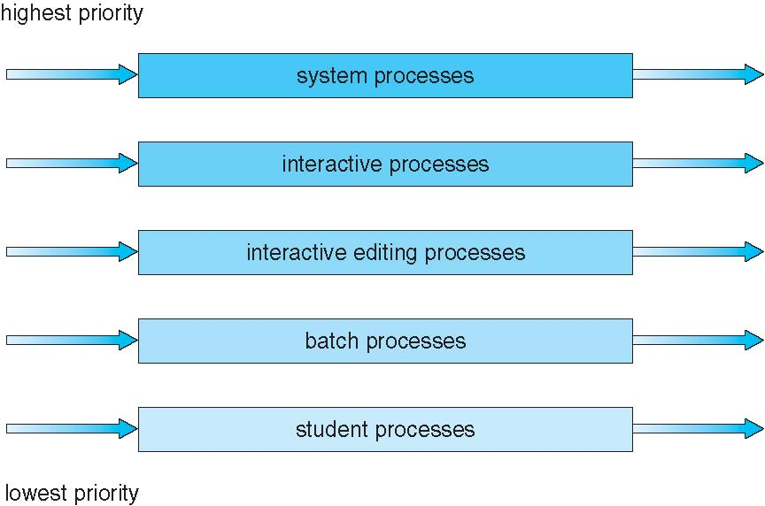

Multilevel Queue Scheduling

Slide 38
Multilevel Feedback Queue scheduling
In multi-level queue processes do not move from one queue to the other----But in
Multilevel Feedback Queue scheduling, allows a process to move between queues.
If a process uses too much CPU time, it will be moved to a lower priority queue.
Similarly, if a process that waits too long in a lower-priority queue may be moved to a higher-priority queue.
This form of aging prevents starvation.
Multilevel-feedback-queue scheduler defined by the following parameters:
number of queues
scheduling algorithms for each queue
method used to determine when to upgrade a process
method used to determine when to demote a process
method used to determine which queue a process will enter when that process needs service

Slide 39
Example of Multilevel Feedback Queue
Three queues: (can see the figure in next slide)
Q₀ – RR with time quantum 8 milliseconds
Q₁ – RR time quantum 16 milliseconds
Q₂ – FCFS
Scheduling
A new job enters queue Q₀ which is served FCFS
When it gains CPU, job receives 8 milliseconds
If it does not finish in 8 milliseconds, job is moved to queue Q₁
At Q₁ job is again served FCFS and receives 16 additional milliseconds
If it still does not complete, it is preempted and moved to queue Q₂

Slide 40
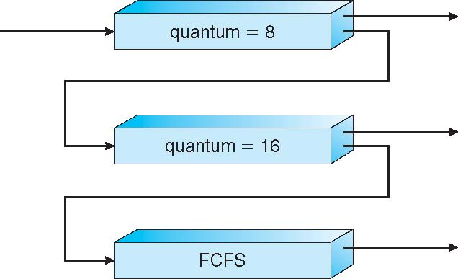
Multilevel Feedback Queues

Slide 41
End of Chapter 6

